Slide 1


SageMaker Security Best Practices
Brief
Notes:
Notes:
I started with the standard Public Sector CheckRide slides and then added/deleted a bunch.
Ensure date is correct
Ensure year of copyright is correct and on every slide
Always include your email address
Always go to AWS Approved Public Stats for the most recent stats.
Introduce yourself and welcome the panel
Good Morning!
Thank you for joining me today.
My name is Debbie Ruttenberg, and I’m a Customer Solutions Manager on the AWS Navy Team
+++++++++++++++++++++++++++++++++++++++++++++++
+++++++++++++++++++++++++++++++++++++++++++++++
Hi everyone, thank you for joining me today, really appreciate you taking the time to speak with me. My name is XXXXXXX, and I am your first point of contact on the AWS Public Sector HealthCare team. If you ever need anything, please do not hesitate to contact me, if I’m able to assist, I am more than happy to. If I myself am not able to, I will put you in touch with the resources who can. _________________________________________________________________________________________________________________________________

Slide 2
SageMaker High Level Processes

Slide 3



Three critical goals…
Non-negotiable Data Security
Self-service Access for Users
End-to-end Governance with Traceability

Slide 4
Hardening Network Security

Slide 5
Ensuring compute and network isolation
All SageMaker components (notebooks, training and hosting instances) should be deployed in and accessed over a private network with no Internet connectivity
All traffic to S3 should be over VPC endpoints
Configure VPC Endpoints for all services the Notebook may need including:
S3
CloudWatch (Training Analytics)
CloudWatch Logs (Training Job logging)
STS (to obtain Notebook IAM role ARN)
SageMaker API (to submit a Training Job)
SageMaker Runtime (to invoke hosting endpoint)
SageMaker Notebook (to access the Notebook from VPC)
Use VPC Endpoint Policies to further limit access to SageMaker resources

Slide 6













Notebook instances - SageMaker egress, no VPC connectivity (default)
Customer Account
Customer VPC
SageMaker Service Account
Availability Zone 1
Availability Zone 2
Private subnet
Private subnet
Auth Proxy Service
SageMaker Platform VPC
SageMaker Platform Egress VPC
Public subnet
Public subnet
Internet Gateway
Notebook
Internet Gateway
S3 bucket
CloudWatch Logs
SageMaker Runtime
SageMaker API

Slide 7

Notebook instances - VPC connectivity (recommended)
Customer Account
Customer VPC
SageMaker Service Account
Availability Zone 1
Availability Zone 2
Private subnet
Private subnet
Auth Proxy Service
SageMaker Platform VPC
SageMaker Platform Egress VPC
Internet Gateway
Notebook
VPC Endpoints
S3 bucket
CloudWatch Logs
SageMaker Runtime
SageMaker API

Slide 8

SageMaker training job default deployment
Customer Account
SageMaker Service Account
Customer VPC
Control Plane
Availability Zone 1
Availability Zone 2
Private subnet
Private subnet
SageMaker Platform VPC
Training Job 1
Platform agents
Platform agents
Algorithm
Algorithm
Internet Gateway
Data agent
Data agent
Log agent
Log agent
Training instance 1
Training instance 2
Data & Algorithm
ENIs
VPC Endpoints
CloudWatch Logs
S3 bucket

Slide 9
SageMaker training job VPC deployment
Customer Account
SageMaker Service Account
Customer VPC
Control Plane
Availability Zone 1
Availability Zone 2
Private subnet
Private subnet
SageMaker Platform VPC
Training Job 1
Data & Algorithm
ENIs
Platform agents
Platform agents
Algorithm
Algorithm
Internet Gateway
Data agent
Data agent
Log agent
Log agent
Training instance 1
Training instance 2
VPC Endpoints
CloudWatch Logs
S3 bucket

Slide 10
SageMaker training job VPC deployment with Network Isolation
Customer Account
SageMaker Service Account
Customer VPC
Control Plane
Availability Zone 1
Availability Zone 2
Private subnet
Private subnet
SageMaker Platform VPC
Training Job 1
Data ENIs
Platform agents
Platform agents
Algorithm
Algorithm
Internet Gateway
Data agent
Data agent
Log agent
Log agent
Training instance 1
Training instance 2
Algorithm ENIs
(no egress)
VPC Endpoints
CloudWatch Logs
S3 bucket

Slide 11
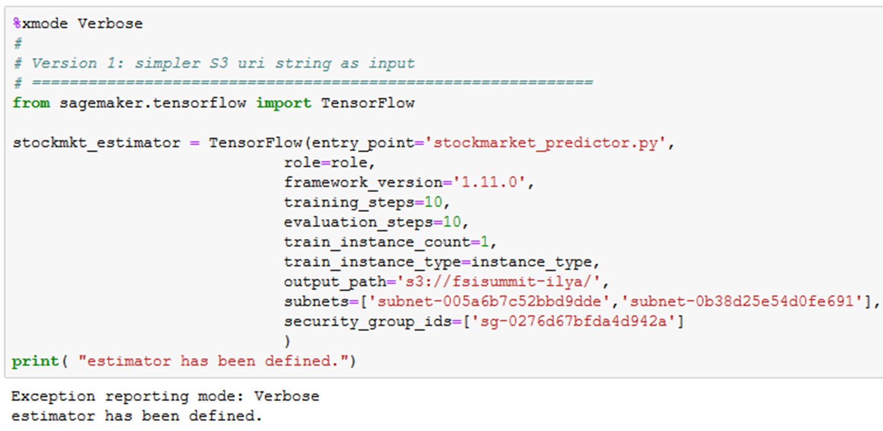
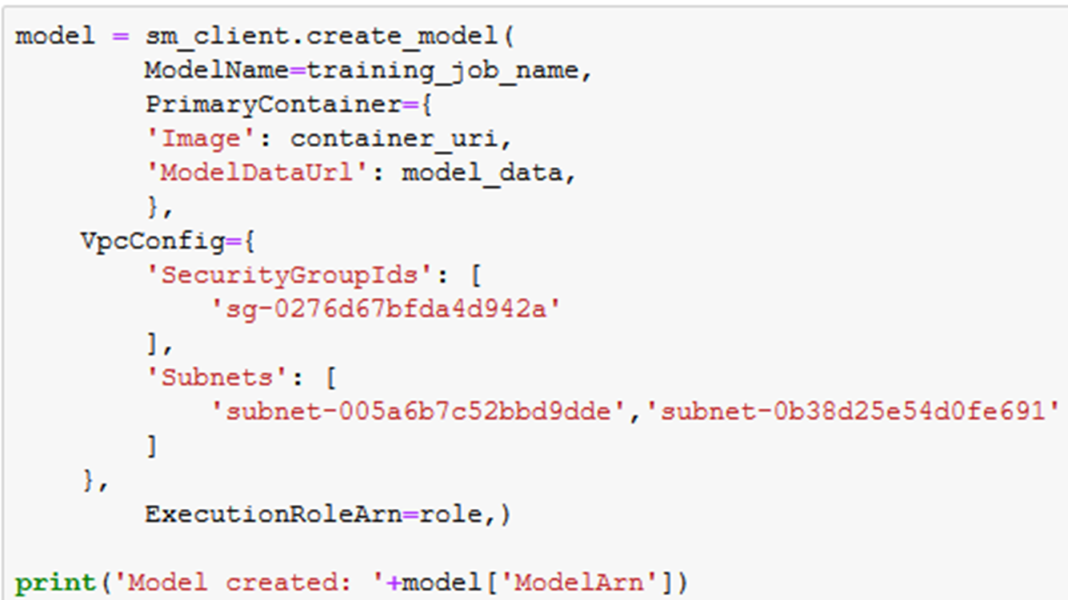
Specifying VPC configurations
Notebook Instance (CloudFormation)
"Resources": {
"notebookInstance": {
"Properties": {
"DirectInternetAccess": "Disabled",
"SecurityGroupIds": [
"{{resolve:ssm:SageMakerSecurityGroupId:1}}"
],
"SubnetId": "{{resolve:ssm:PrivateSubnetAId:1}}",
"VolumeSizeInGB": {
"Ref": "VolumeSize"
}
}…..
Training Job (SageMaker SDK)
Model Hosting (Boto3)

Slide 12




Preventative controls to enable self-service…
How to ensure users comply with security controls?
How to keep users from stepping on each other?
Amazon SageMaker
IAM context
keys
AWS Service Catalog
provisioning
Tagging
& resource
grouping

Slide 13
IAM condition keys for Amazon SageMaker
Network and Compute Isolation
sagemaker:DirectInternetAccess
Disable internet access for Notebook Instances
sagemaker:NetworkIsolation
Require network isolation for SageMaker jobs
sagemaker:VpcSecurityGroupIds
sagemaker:VpcSubnets
Require use of specified subnets and SGs
sagemaker:InterContainerTrafficEncryption
Encrypt traffic between distributed instances
Data Protection
sagemaker:OutputKmsKey
S3 encryption for artifacts
sagemaker:VolumeKmsKey
CMK for EBS volume encryption
sagemaker:RootAccess
Disable access to Notebook Instance root volume
sagemaker:WorkteamType
Control team types available for Ground Truth labeling (e.g, Private only)

Slide 14
IAM condition keys for Amazon SageMaker
“Condition”: {
“ArnEquals”: {
“sagemaker:VolumeKmsKey”: “kms-1234”
}
Notebook creation
sagemaker:VolumeKmsKey
sagemaker:VpcSecurityGroupIds
sagemaker:VpcSubnets
sagemaker:RootAccess
sagemaker:DirectInternetAccess
Training job creation
sagemaker:VolumeKmsKey
sagemaker:OutputKmsKey
sagemaker:VpcSecurityGroupIds
sagemaker:VpcSubnets
sagemaker:NetworkIsolation
Endpoint creation
sagemaker:VolumeKmsKey
sagemaker:VpcSecurityGroupIds
sagemaker:VpcSubnets
sagemaker:NetworkIsolation
sagemaker:ModelArn
"Effect":"Allow",
"Condition":{
"ForAllValues:StringEqualsIfExists":{
"sagemaker:VpcSubnets":[
"{{resolve:ssm:PrivateSubnetA:1}}",
"{{resolve:ssm:PrivateSubnetB:1}}"
],
"sagemaker:VpcSecurityGroupIds":[
"{{resolve:ssm:SMSecurityGroupId:1}}"
]
}
}
Notes:
Notebook creation
sagemaker:VolumeKmsKey (ARN)
sagemaker:VpcSecurityGroupIds (string array)
sagemaker:VpcSubnets (string array)
sagemaker:RootAccess (string)
sagemaker:DirectInternetAccess (string)
{
"Effect": "Allow",
"Action": “sagemaker:CreateNotebookInstance”,
"Resource": "*",
"Condition": {
“StringEquals”: {
”sagemaker:DirectInternetAccess”: “Disabled”
},
“StringEquals”: {
”sagemaker:RootAccess”: “Disabled”
},
“ForAnyValue:StringEquals”: {
“sagemaker:VpcSubnets”: [
“subnet-aaa1234”,
“subnet-bbbb1234”
]
},
“ForAllValue:StringEquals”: {
“sagemaker:VpcSecurityGroupIds: [
“sg-1234567890”
]
},
“ArnEquals”: {
“sagemaker:VolumeKmsKey”: “kms-1234”
}
}
}

Slide 15

Access controls enforcement: Examples
{
"Effect": "Allow",
"Action": "sagemaker:CreateTrainingJob" ,
"Resource": "arn:aws:sagemaker:x:x:*/app1-*",
"Condition": {
"StringEquals": {
"aws:RequestTag/CostCenter": "x",
"sagemaker:VolumeKmsKey": "arn:aws:kms:x:x:key/x"
},
"Bool": {
"sagemaker:InterContainerTrafficEncryption": "true",
"sagemaker:NetworkIsolation": "true"
},
"ForAllValues:StringEquals": {
"sagemaker:VpcSubnets": [
"subnet-a",
"subnet-b"
],
"sagemaker:VpcSecurityGroupIds": [
"sg-x",
"sg-y"
]
},
"Null": {
"sagemaker:VpcSubnets": "false"
}
}
}
Network and encryption enforcement
Notebook access control
{
"Effect": "Deny",
"Action": "sagemaker:CreatePresignedNotebookInstanceUrl",
"Resource": "*",
"Condition": {
"ForAllValues:StringNotEquals": {
"sagemaker:ResourceTag/creatorUserId": "${aws:userId}"
}
}
}

Slide 16
SageMaker notebook – limit access to Notebook by SourceIp or SourceVpce
{
{
"Effect": "Allow",
"Action": "sagemaker:CreatePresignedNotebookInstanceUrl",
"Resource": "*",
"Condition": {
"IpAddress": {
"aws:SourceIp": [
"192.0.2.0/24",
"203.0.113.0/24"
]
}
}
}
]
}
{
"Id": "notebook-example-1",
"Version": "2012-10-17",
"Statement": [
{
"Sid": "Enable Notebook Access",
"Effect": "Allow",
"Action": [
"sagemaker:CreatePresignedNotebookInstanceUrl",
"sagemaker:DescribeNotebookInstance"
],
"Resource": "*",
"Condition": {
"ForAnyValue:StringEquals": {
"aws:sourceVpce": [
"vpce-111bbccc",
"vpce-111bbddd"
]
}
}
}
]
}
One of the values for aws:SourceVpce is the ID of the interface endpoint for the notebook. The other is the ID of the interface endpoint for the Amazon SageMaker API.

Slide 17
Best Practices ML Pipeline Approach

Slide 18
Key Customer ask
Customizable production grade orchestration of ML pipeline activities
Minimum management
Maximum flexibility
Reusable solution across Enterprise, but individual teams need to be able customize functionality
Use only customer approved AWS services
Audit and model approval workflow support

Slide 19
CodePipeline

Slide 20










CodePipeline orchestrated ML pipeline
Reproducible and reusable pipeline
Built-in audit tracking capability
Leverages familiar CICD tooling
AWS Cloud
Source code
AWS CodeCommit
Amazon ECR
Train
Model
artifacts
Deploy endpoint
AWS CodePipeline
AWS CodeBuild
Lambda
Approval gate
Lambda
Create model
Dataset
Amazon DynamoDB
Amazon S3
AWS Lambda
Model metadata for audit tracking
Batch transform
Build
Train
Deploy

Slide 21
Step Functions

Slide 22
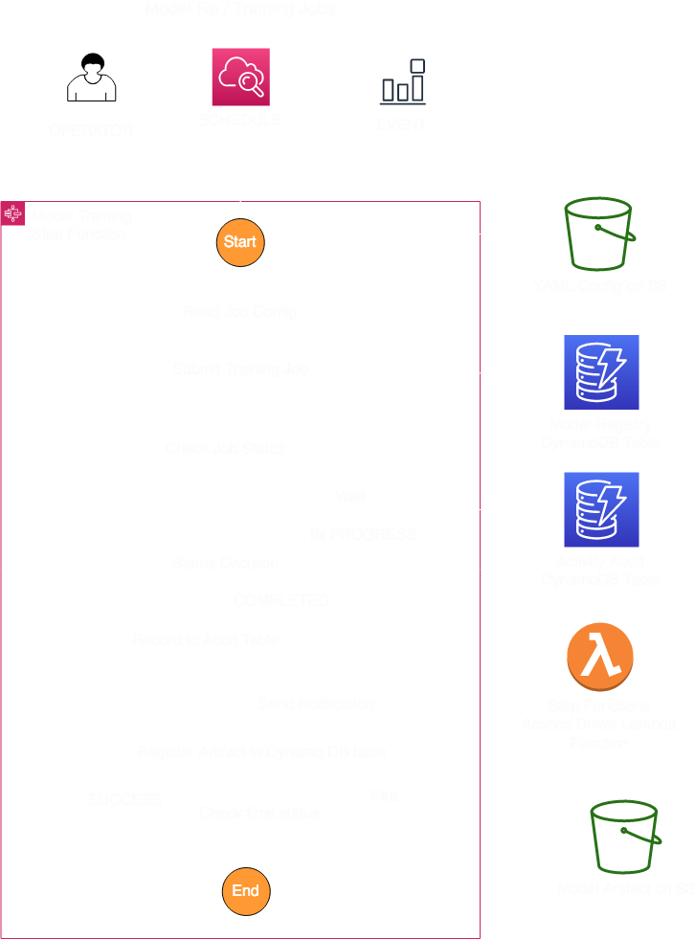
Main components
Reusable Step Functions Definitions
Generic Lambda Function aka driver for step functions
Customer YAML configs aka Configure Everything
Lambda layers – for any additional libraries including SageMaker SDK

Slide 23
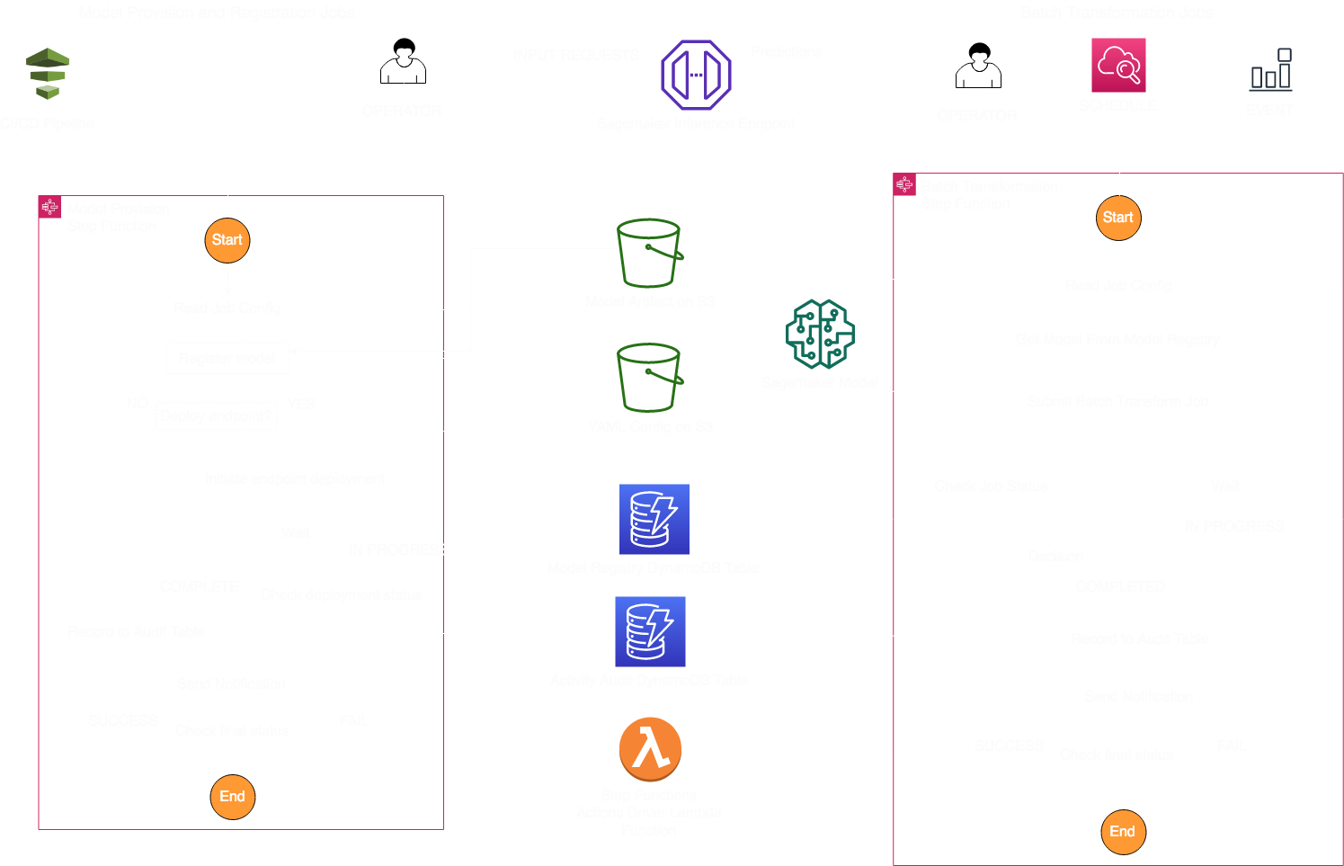

Slide 24
Jobs configuration
general_properties: proj_name: ”Team-XYZ-Model-ABC" role: "arn:aws:iam::741234567890:role/sagemaker-role" kmsId: "arn:aws:kms:us-east-1:741234567890:key/kms-key" job_audit_table: ”audit-table-name" models_registry_table: ”model-registry-table-name" SecurityGroupIds: ["sg-123456", "sg-567890"] Subnets: ["subnet-1234567", "subnet-0987656"] Tags: "" Jobs: training: dataLocation: "s3://my-bucket/training/data" imageName: "741234567890.dkr.ecr.us-east-1.amazonaws.com/customer/container:latest" trainingInputMode: "File" instanceType: "ml.m4.10xlarge" instanceCount: 10

Slide 25
Lambda function
def execute_action(action, func_context): if action is not None: supported_actions = { "test-action": str, "read-configuration": orchestration.fetch_configuration_by_job, "submit-training-job": orchestration.submit_training_job, "check-training-job-status": orchestration.check_training_job_status, "log-job-detail": orchestration.log_job_detail, "submit-batchtransform-job": orchestration.submit_batchtranform_job, "check-batchtransform-job-status": orchestration.check_batchtranform_job_status, "send-status-notification": orchestration.send_status_notification, "get-model-name": orchestration.get_model_for_batchtransform, "log-model-registry": orchestration.model_registry_put_item, "provision-model": orchestration.provision_model, "provision-endpoint": orchestration.provision_endpoint, "check-endpoint-status": orchestration.check_endpoint_status, } if action in supported_actions: return supported_actions[action](func_context) else: raise KeyError(f"[ERROR] Requested action {action} is not supported")

Slide 26
Updated integrations for Step Functions
{
"SageMaker CreateTransformJob": {
"Type": "Task",
"Resource": "arn:aws:states:::sagemaker:createTransformJob.sync",
"Parameters": {
"ModelName": "SageMakerCreateTransformJobModel-9iFBKsYti9vr",
"TransformInput": {
"CompressionType": "None",
"ContentType": "text/csv",
"DataSource": {
"S3DataSource": {
"S3DataType": "S3Prefix",
"S3Uri": "s3://my-s3bucket-example-1/TransformJobDataInput.txt"
}
}
},
"TransformOutput": {
"S3OutputPath": "s3://my-s3bucket-example-1/TransformJobOutputPath"
},
"TransformResources": {
"InstanceCount": 1,
"InstanceType": "ml.m4.xlarge"
},
"TransformJobName": "sfn-binary-classification-prediction"
},
"Next": "ValidateOutput"
},
CreateEndpoint
CreateEndpointConfig
CreateHyperParameterTuningJob
CreateLabelingJob
CreateModel
CreateTransformJob
CreateTrainingJob.
UpdateEndpoint

Slide 27

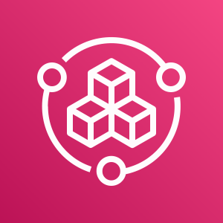

AI/ML Pipeline – Goverance
Data Lake Account (PROD)
Micro-account(PROD)
S3 Copy of Data
Dataset
Model Source code
AmazonS3
AWS CodeCommit
AWS Service Catalog
AWS CodePipeline
Amazon ECR
Train & Evaluation
Model
artifacts
Approval gate
Deployment Account(PROD)
Governance Account (TEST)
Staging Account(TEST)
AmazonS3
AWS Service Catalog
Amazon ECR
Deploy endpoint
Security Tools
AWS CodeCommit
AWS CodePipeline
Security Artifacts
Copy of Model Artifacts
AWS Service Catalog
Amazon ECR
Deploy endpoint
AWS SNS

Slide 28
High Level Governance Operating Model
Security
Operations
Mission Unit 1
Mission Unit 2
Cloud PMO
App1
App2
Operations-Application
App1
App2
Operations-Application
Finance
Procurement
Cloud Platform Engineering
Infrastructure
Services
Database Service
Security
Services
Operations- Platform
Risk
Legal

Slide 29

Amazon SageMaker... re:Invent updates
NEW!
Amazon SageMaker Studio IDE
NEW!
NEW!
NEW!
NEW!
NEW!
Reinforcement
Learning
Deployment
and
Hosting
SageMaker Model Monitor
Ground Truth
ML
Marketplace
Algorithms
and
Frameworks
SageMaker
Notebooks
Training
and
Tuning
SageMaker
Experiments
SageMaker
Debugger
SageMaker
Autopilot
Neo
Amazon SageMaker

Slide 30
New SageMaker services and features
Service Name | Uses SageMaker Underlying Services | Enherited Compliance? | Network Isolation/Privacy | Encryption at Rest | Encryption in Transit | Customer Data
SageMaker Autopilot | Processing job, Training job, Transform job, Tuning job | YES, Including SOC2 | VPC mode PrivateLink EnableNetworkIsolation | KMS CMK for S3 and ML EBS volumes | Processing jobs don’t support inter- networking encryption | Does not store or process any customer data, just metadata
SageMaker Debugger | Processing job, Training job | YES, Including SOC2 | VPC mode PrivateLink EnableNetworkIsolation | KMS CMK for S3 and ML EBS volumes Metrics in DynamoDB are encrypted with service managed key | Processing jobs don’t support inter networking encryption, but all rule jobs are single node today | For built in rules, the stored metrics in DDB are metadata only. For BYO containers customers can put any data as metrics
SageMaker Experiments |  | YES, Including SOC2 | Multi-tenant metadata service | Does not store or process customer data, just metadata | Does not store or process customer data, just metadata | Does not store or process customer data, just metadata
SageMaker Search | Indexes training jobs and experiments describe API calls | YES, Including SOC2 | Multi-tenant metadata search service | Does not store or process customer data, just metadata | Does not store or process customer data, just metadata | Does not store or process customer data, just metadata
SageMaker Model Monitor | SageMaker Hosting with an S3 upload agent, Processing job | YES, Including SOC2 | VPC mode PrivateLink EnableNetworkIsolation | KMS CMK for S3 and ML EBS volumes | Processing jobs don’t support inter- networking encryption | All captured data is stored in customer’s S3 bucket with KMS CMK

